Slide 1
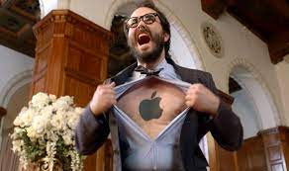
I love Apple!
They build Macs, iPhones and iPads, I can’t breathe without Apple products!
I am going to buy AAPL stocks to support them!
BUT I DO NOT WANT TO LOSE MONEY FOR MY LOVE ☹
A guy who is a crazy apple fan
Notes:
Apple is a great company. They build outstanding hard wares and soft wares. Many of us enjoy the convenience of cooperation of iPhones, iPads, Apple Watches and Macs. Then a group called “apple fan” merged. However, some apple fans love apple so much that they even want to buy apple stocks to prove that their love is TRUE love. Just like this guy. I believe he must be a perfect husband if he has been married.
This guy wants to buy stocks but only apple stocks. However, he loves his money too. The last thing he wants to see is seeing apple get defeated by other tech companies just like Google, SUMSANG or HUAWEI. Nevertheless, losing money comes just behind. It is the second last thing he wants to see. So, we are trying to build a model to invest apple and make a profit, or to say, minimize his loss.

Slide 2
Today, we are embarking on a journey to build a model that will help him profit from Apple or, at the very least, minimize his losses.

Slide 3
COMP7409 Machine Learning in Trading and Finance
Evaluating Impact of Social Media Posts
on Stock Prices
Group number: 3
Group members: Wang Dingrui, Chen Kewen, Wang Yijie, Yang Sihan, Cao Jia
汇报时间：2023/05/31

Slide 4
contents
01
Research Overview
02
Data Preparation
03
Feature Engineering
04
Experiments

Slide 5
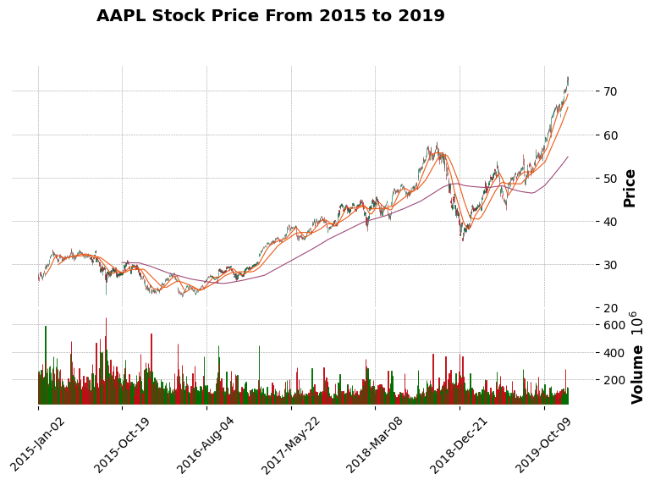
1
Research overview
Sub-tasks:
• Task 1: Examine the effect of social media sentiment on stock closing prices.
• Task 2: Four models, RNN, LSTM, MLP and GRU model were used for model comparative experiments.
• Task 3: Provide stock prediction results based on selected model and explore the returns with a trading strategy.
Key technology
Financial Texts, Stock Market Prediction, Sentiment Analysis
Target
Investigate whether social media sentiment about a particular stock contributes to predicting its close price.
Notes:
So, the first experiment we are going to use pure stock price data, which we called as the base one, compared with two sentimental data.
Or just the garbage.

Slide 6

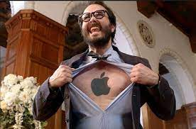
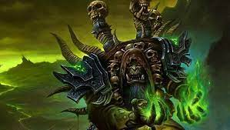
I can’t wait to dive in the market!
Show me your model
Easy dude, before we build the model, we need to prepare the data. Data is to a model what fel magic is to Gul'dan.
Don’t cue me!

Slide 7
2
Data Collection
Twitter Data ‘AAPL’ (for Apple)
Total 1424714 pieces of data.
This dataset contains features like date, username and body from 2015 to 2020.
Data source: https://www.kaggle.com/datasets/omermetinn/tweets-about-the-top-companies-from-2015-to-2020
Historical Stock Data
Total trading day: 1258
The historical stock data separately for each company stock or decentralised currency from from 2015 to 2020.
This dataset contains the features – ‘open’: the share price of a single stock at the start of the day, ‘high’: the highest price at which the stock was sold on that day, ‘low’: the lowest price the stock was sold on that day, ‘volume’ : total number of shares that were sold or bought on that day, and ‘close’: the closing price of a single stock on that day.
Data source: yahoo finance

Slide 8
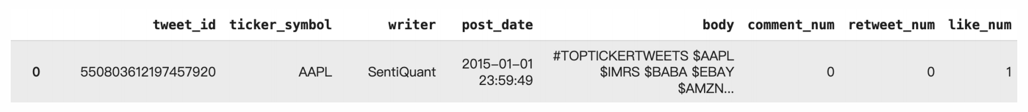
2
Data Preprocessing
Tweet Data
Original Dataset:
Table A:{tweet_id, ticker_symbol}
Table B :{tweet_id, ticker_symbol, writer,post_date, body,comment_num, retweet_num, like_num}
Data processing:
joint: on a.tweet_id = b.tweet_id, where ticker = 'AAPL'
timestamp to datetime:
timestamp = datetime.datetime.fromtimestamp(Date).strftime('%Y-%m-%d %H:%M:%S')

Slide 9
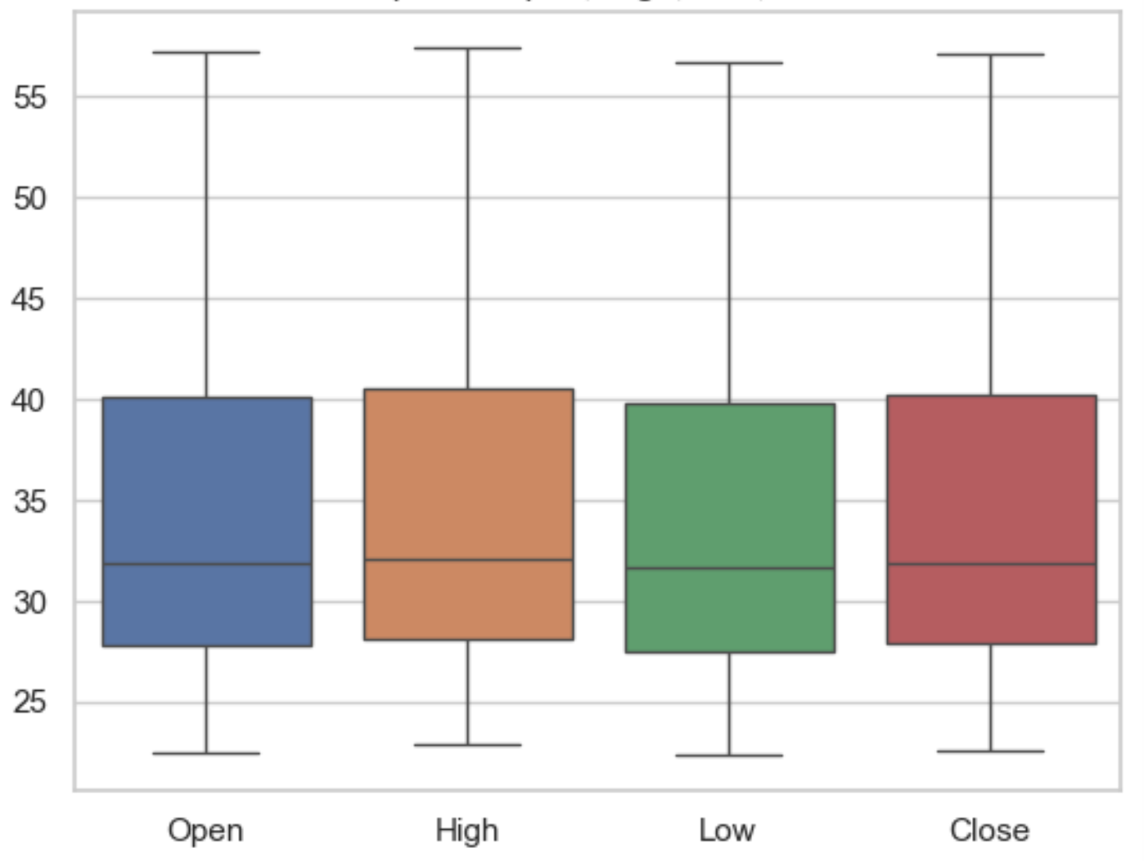
2
Data Preprocessing - Stock Data
Outlier detection of Open, High, Low, Close

Slide 10
3
Feature Engineering
Feature construction
Sentiment Analysis:
FinBert-sentiment
Vader-sentiment
Notes:
we use two different sentimental analysis models, VADER and FinBERT to evaluate the sentimental score of each tweet.

Slide 11
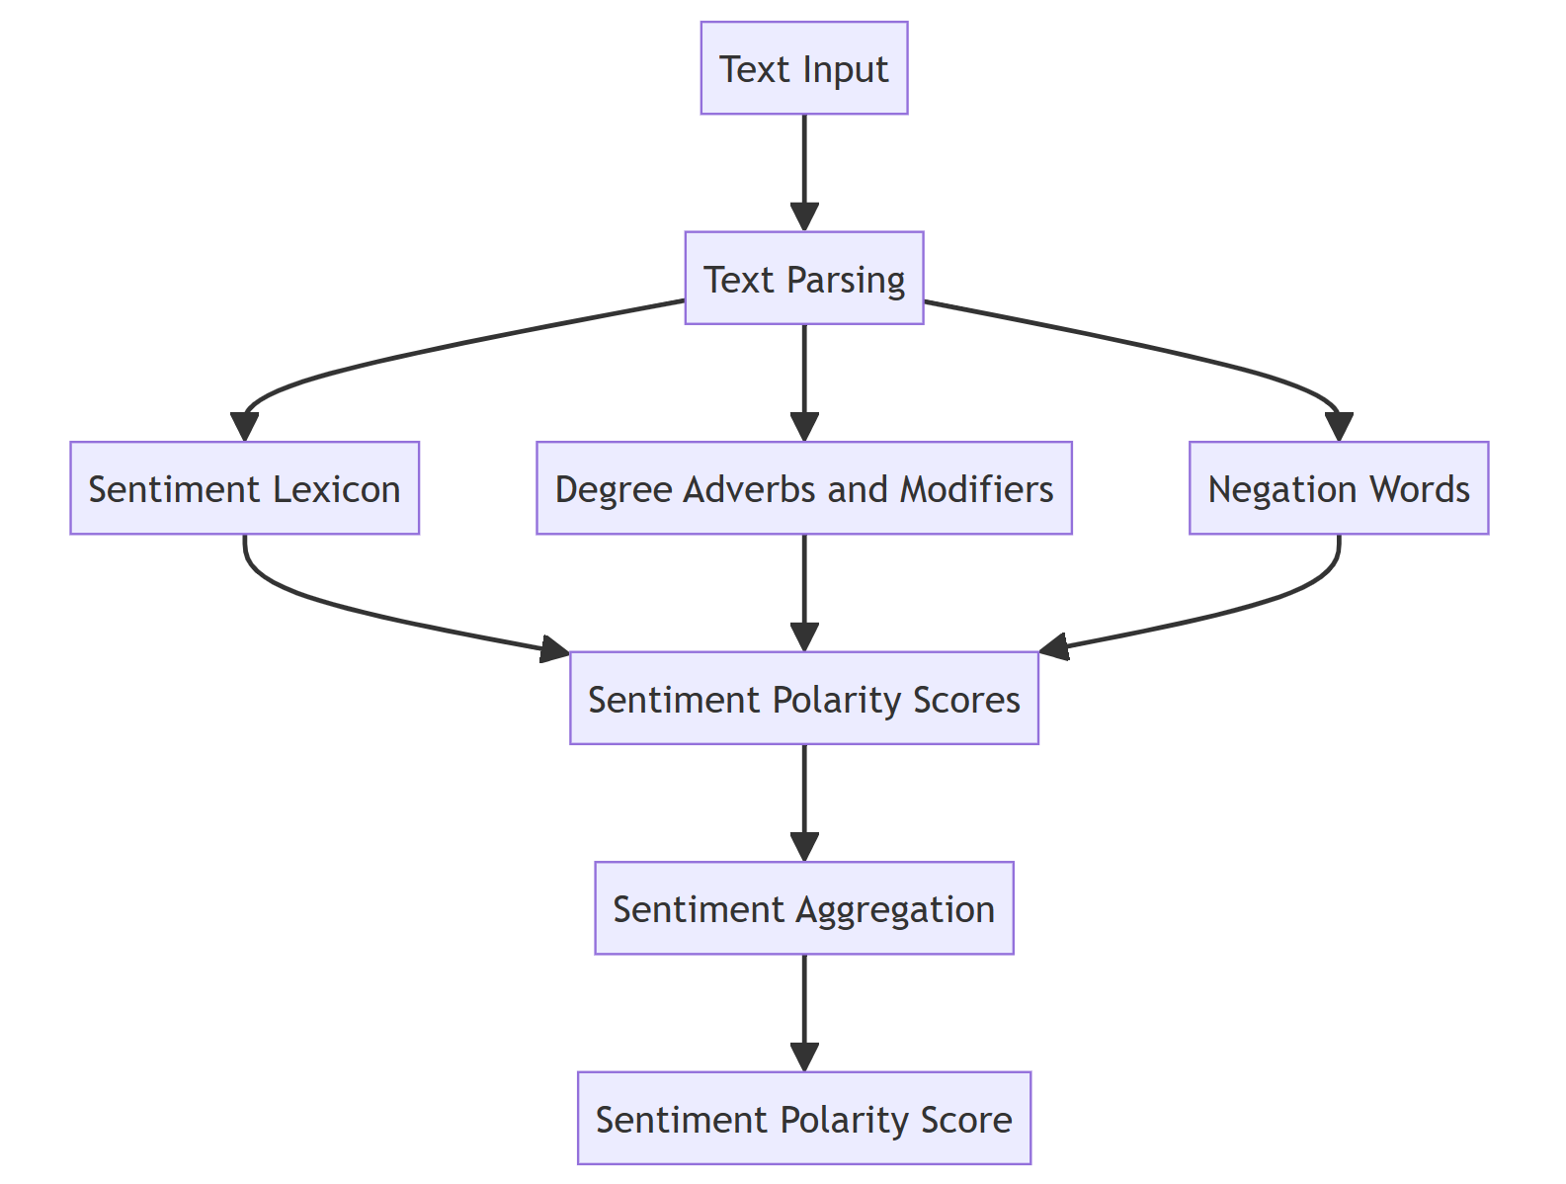
3
VADER
VADER is a text sentiment analysis method based on thesaurus and grammar rules.
Notes:
VADER is a traditional machine learning method; it is widely used today because it is really fast and resource-saving.

Slide 12
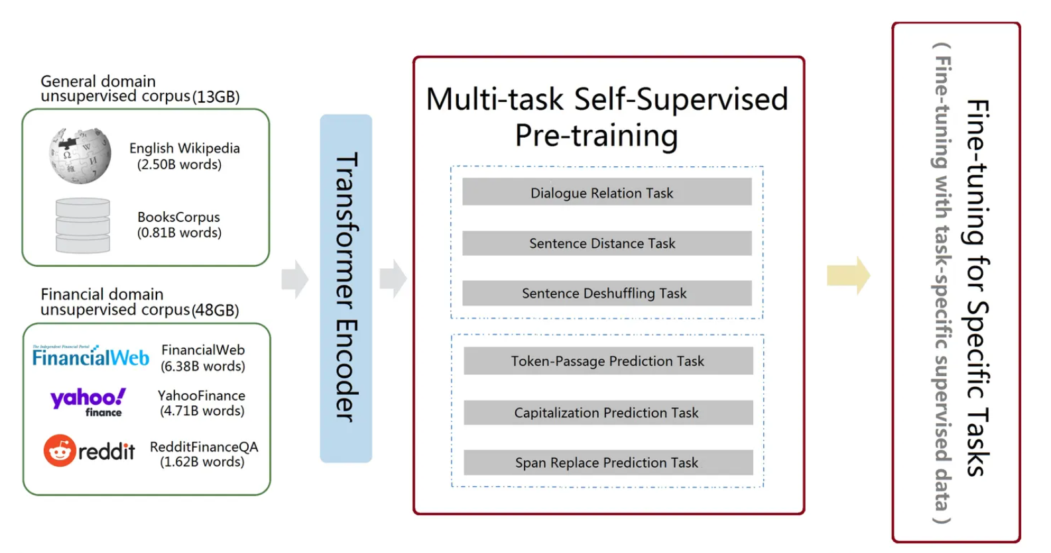
3
FinBERT
Typical "pre-training" + "fine-tuning" architecture
Notes:
FinBERT, it is a pretrained large model. It is much slower than VADER, and it costs a lot of computing resources,50h. However, the outcome of FinBERT is very marvel.

Slide 13
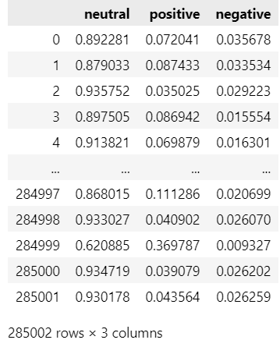
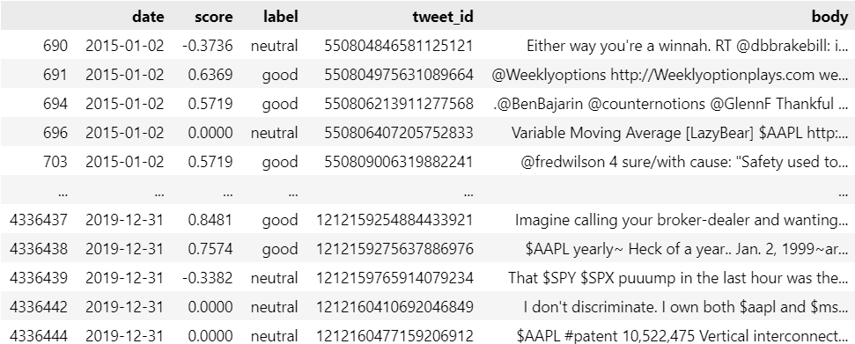
3
Sentiment Analysis
Vader’s Result
FinBERT’s Result

Slide 14
3
Feature Engineering
Feature extraction
ewma_close_price
In order to predict closing prices more accurately, a new variable mean moving average derived from existing variables is introduced. The index weighted moving average takes into account closing prices on 3, 7, 14 and 30 days. The intuition behind the use of four different ewma values is to cover long-term changes in stock prices.
close_price_shifted
the close price of the next day

Slide 15
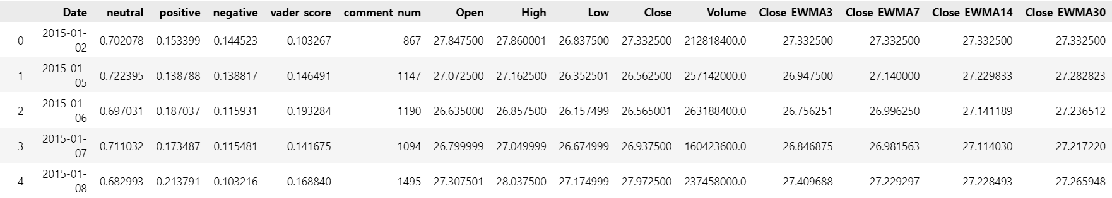
3
Feature Engineering
Feature selection
groupby(‘Date’).mean()
dropna()
feature selection
Sentiment for each tweet
Sentiment for each day
Merge
Drop about 100 data
X,Y

Slide 16
Now! my wallet is screaming!
Okay, let us construct the model. To be frank, I am not sure if you are a good investor. I will try my best to protect your wallet.
Notes:
It seems that this guy is eager to do something terrible. But for sake of the safety of his wallet, we must do the experiments to prove the efficiency of our model.

Slide 17
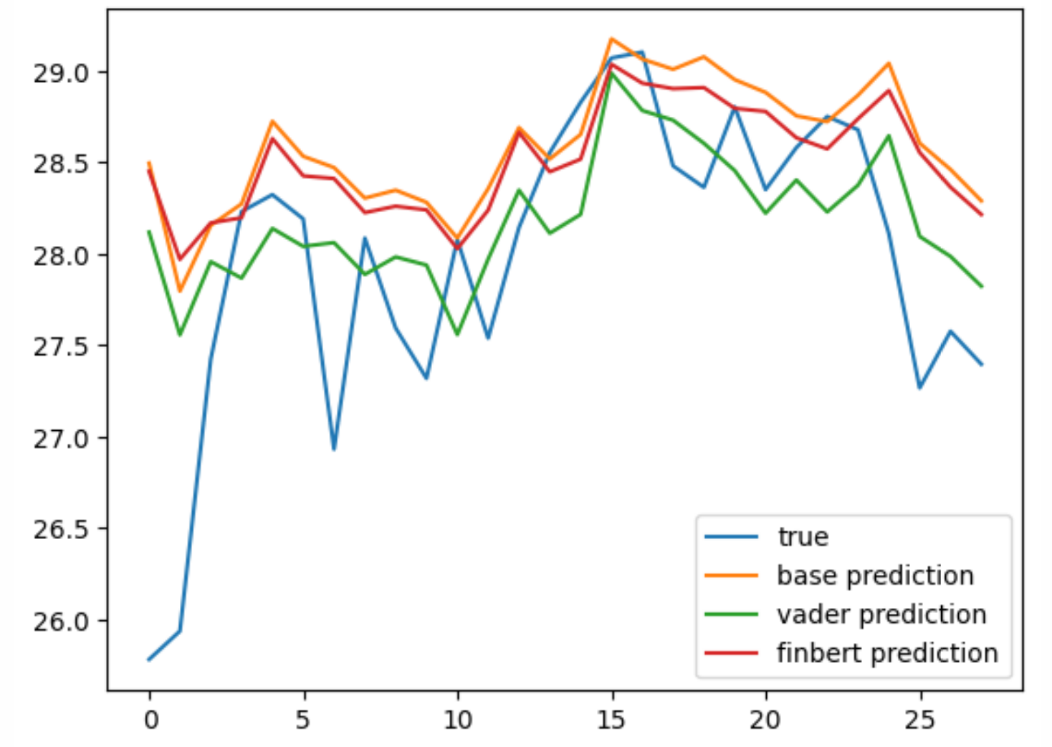
4
Experiments and Result Analysis
E1: Examine the effect of social media sentiment on stock closing prices
AAPL stock data as the base dataset
twitter as the sentimental data source
Use VADER and FinBERT as the sentiment analysis tools
based on simple LSTM
Notes:
!!! Train: dev: test = 8:1:1

Slide 18
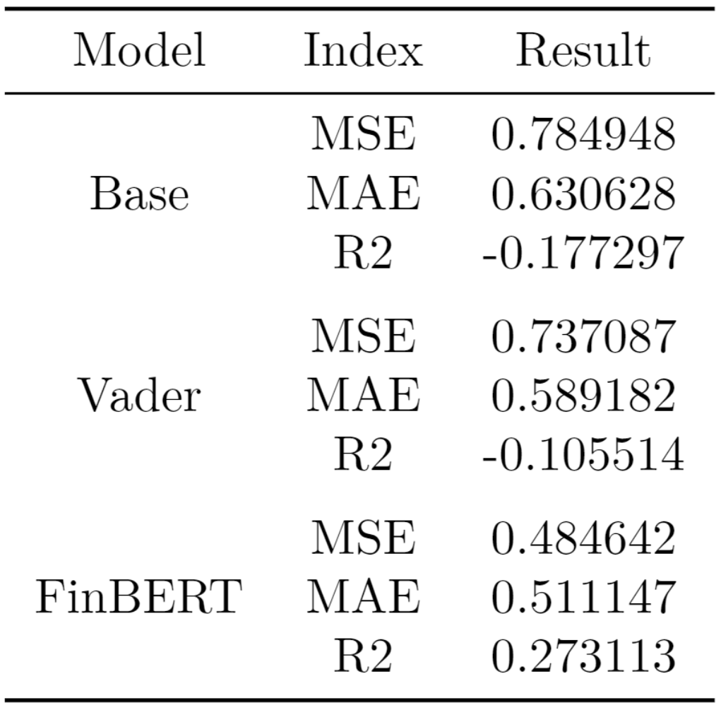
4
Experiments and Result Analysis
E1: Examine the effect of social media sentiment on stock closing prices
Conclusion:
Social media sentiment has an impact on stock closing prices
The prediction effect of sentiment analysis made with FinBERT is the best, and subsequent experiments are based on this data set base + FinBERT

Slide 19

E1: Examine the effect of social media sentiment on stock closing prices
It seems that FinBERT is the

Slide 20
Chosen Networks |  | Discarded Networks
RNN | - Simple recurrent structure - Suitable for modeling and predicting sequence data - Fast training speed - Limited memory capacity for handling long-term dependencies | Bidirectional Networks | Reason: in trading and fiancé, we can’t see the data from the future, so bidirectional networks like Bi-RNN, Bi-LSTM and Bi-GRU are meaningless
GRU | - Gated recurrent structure - Handles long-term dependencies and memory - Moderate training speed - Medium memory capacity
LSTM | - Gated recurrent structure - Handles long-term dependencies and memory - Slower training speed - High memory capacity
MLT | - Feedforward structure - Used for classification, regression, and other machine learning tasks - Fast training speed - Lacks explicit memory capacity - Large number of parameters | CNN | Reason: CNN is usually used in matrix computations, like computer vision. In this experiment, we use serial data, which is not appropriate to use CNN.

Slide 21
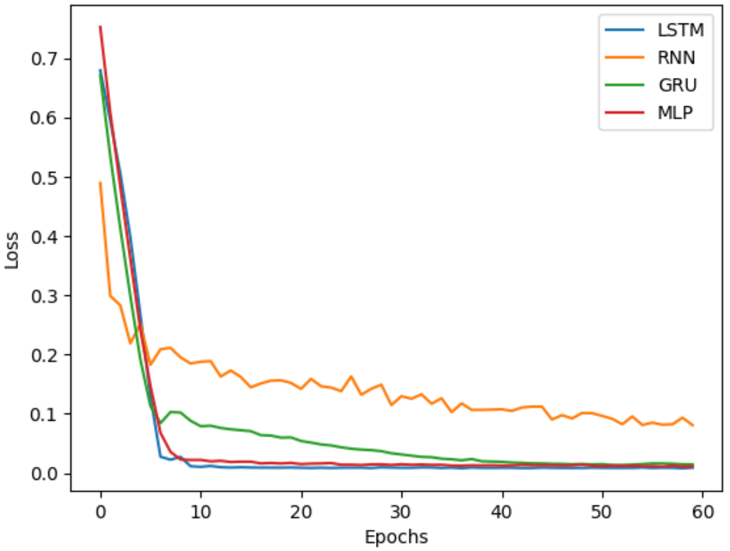
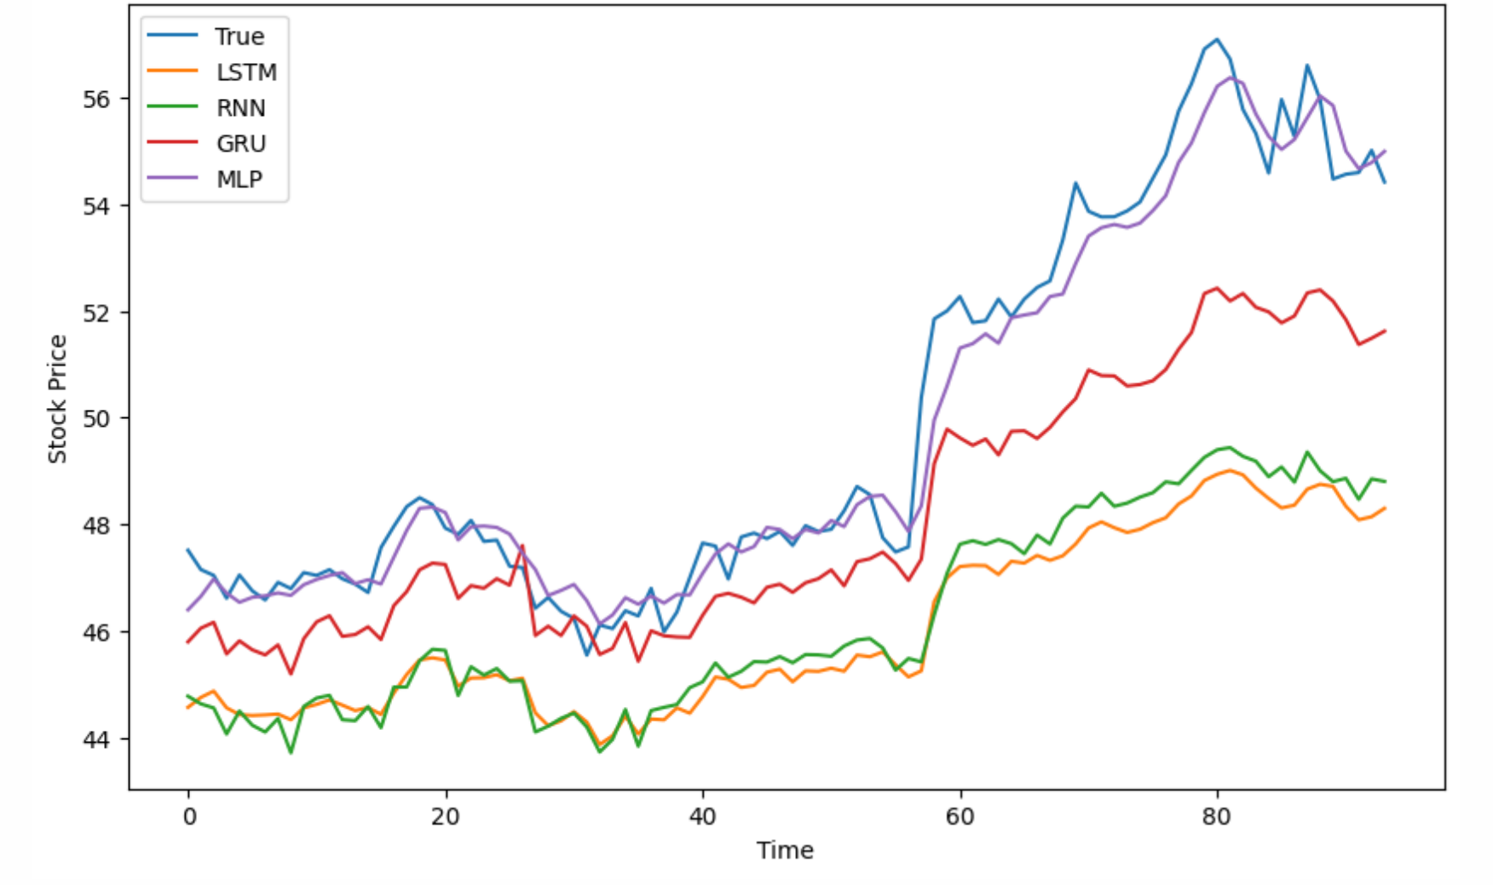
4
Experiments and Result Analysis
E2: Model comparison
Loss of Different Models in Experiment 2
Comparison of Predicted and True Values

Slide 22
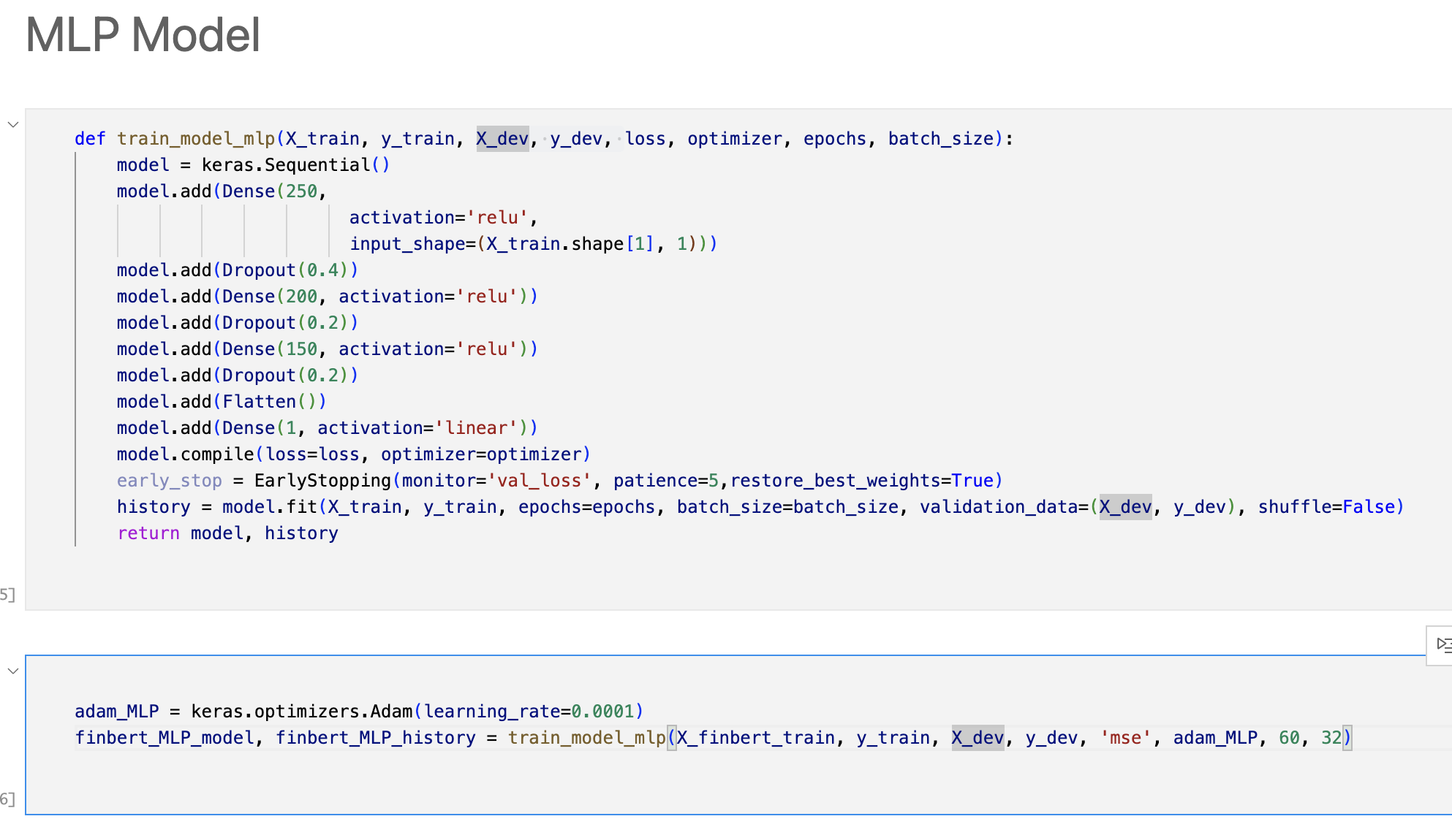
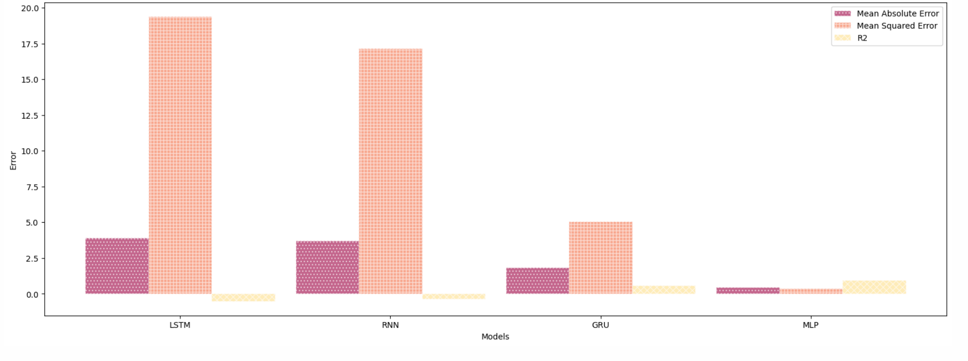
4
Experiments and Result Analysis
E2: Model comparison
Errors of Different Models
Conclusion: MLP model has the best effect on dev set, and the MLP model will be used in subsequent experiments
Notes:
ten to the power of negative four

Slide 23
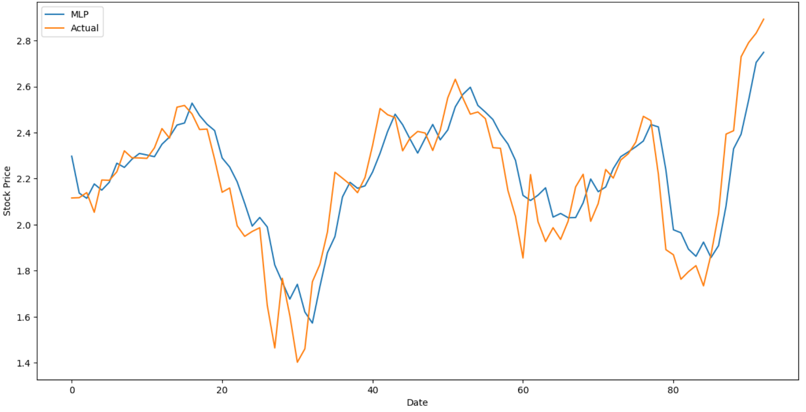
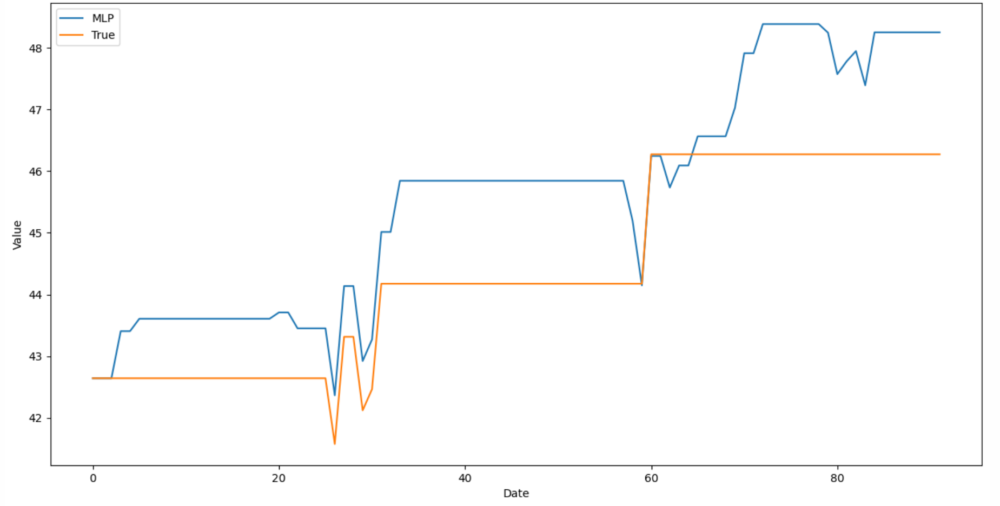
4
Experiments and Result Analysis
E3: Stock Price forecasting and strategy
based on MLP
Stock price prediction using MLP VS Actual
The initial position is 1.
Strategy: Use the model to predict the closing price of t+1 on day t.
If close_predict_{(t+1)} > close_actual_{(t)}, buy short positions, hold no action.
If close_predict_{(t+1) <} close_actual_{(t)}, the position is sold, empty positions do not act.

Slide 24
Money! Apple!
The two greatest things in the world!
Careful, young man. We really hope you can benefit forever, but we know that it is impossible.

Slide 25

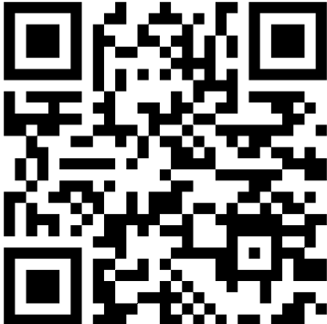
Our codes and other
materials are posted on
https://github.com/NoW0NDER/ML_final

Slide 26
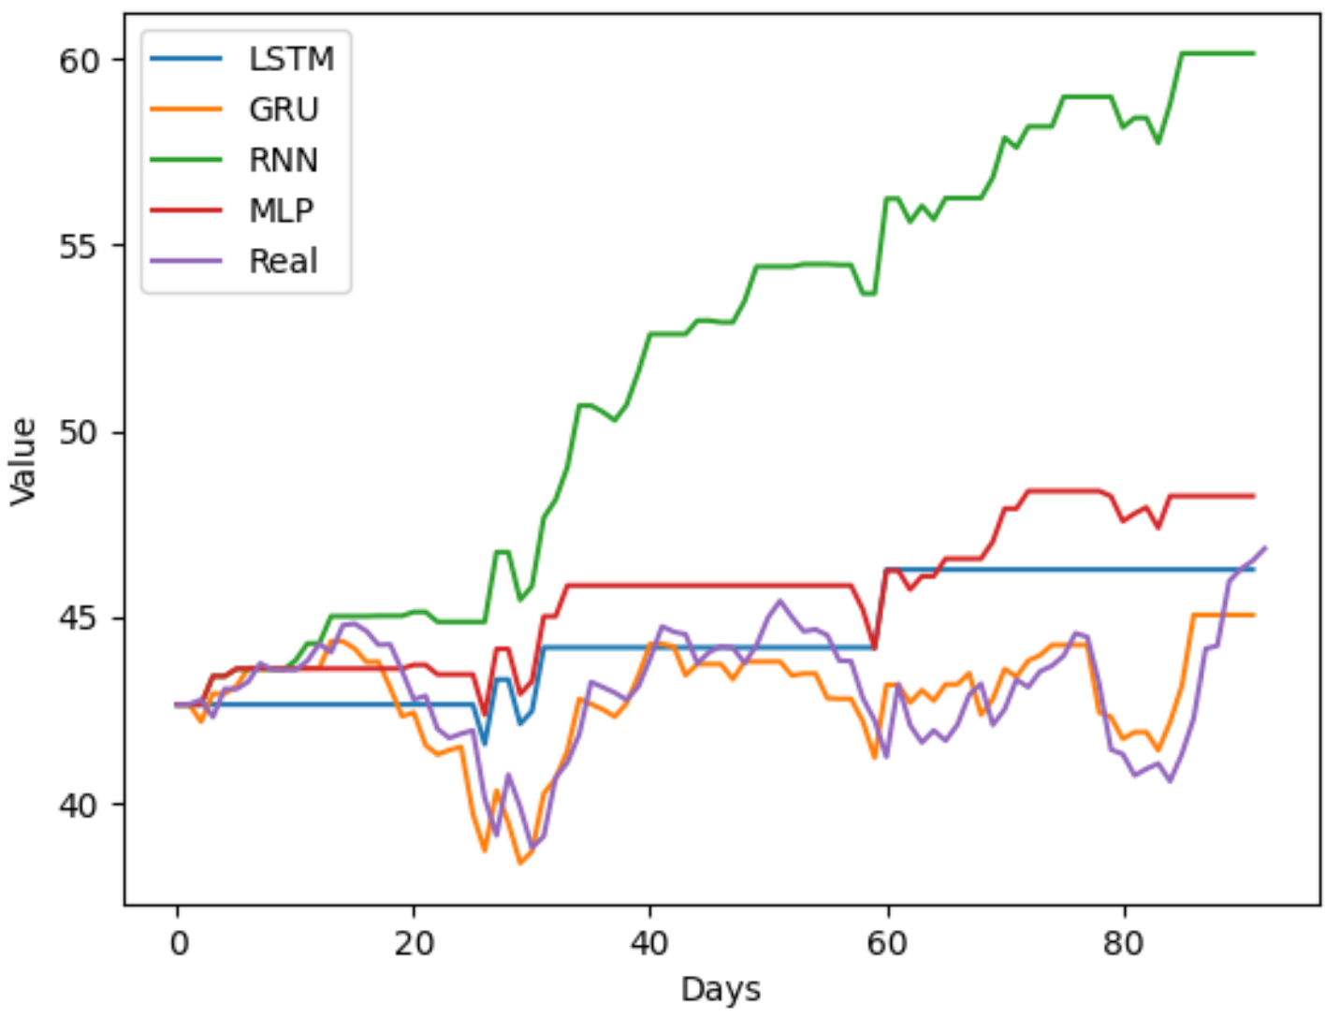
5
Easter Egg
The returns of different models using the same investment strategy

Slide 27
4
Experiments and Result Analysis
Limitations:
Future work:
Finbert API related issues:
The connection is unstable
Can't handle overly long text
The computing time is too long
Problems related to DataSets
NuLL value: null value brought by the Finbert API
Time interval: Limited by the available Twitter data set (Twitter api)
Recall the FinBERT model to handle the missing value caused by server disconnection
Compare the effect of social media comments of the general public and executives on stock price prediction
Dive in quantitative strategy research

Slide 28
COMP7409 Machine Learning in Trading and Finance
Thank you !
Group number: 3
Group members: Wang Dingrui, Chen Kewen, Wang Yijie, Yang Sihan, Cao Jia
汇报时间：2023/05/31

